Slide 1
Data Visualization
Daily_ozone_2020 Data
Air Quality Index
Group 7 PROJECT

Slide 2
Performed By:
Joud Alahmari | 2008071
Afraa Farhan | 1808552
Manar Bagabas | 2005686
Mashael Alshehri | 2006205

Slide 3
Introduction
AirData assists a wide range of people, from the concerned citizen who wants to know how many unhealthy air quality days there were in his county last year to air quality analysts in the regulatory, academic, and health research communities who need raw data.

Slide 4
01
Task
Fix data types, Convert to measure or dimension and/or create hierarchies

Slide 5
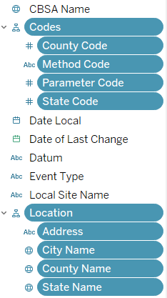
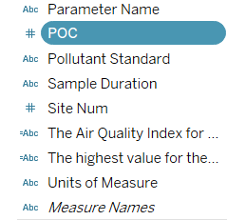
Hierarchy named: Codes
Hierarchy named: Location
Convert POC -> Dimension
This is the “Parameter Occurrence Code” used to distinguish different instruments that measure the same parameter at the same site.

Slide 6
02
Task
Visualize single variables (at least one single categorical and one single continuous) relevant to your questions
Visualize two continuous variables versus each other (at least one visual required) relevant to your questions
Visualize two variables of different types versus each other (at least one visual required) relevant to your questions

Slide 7
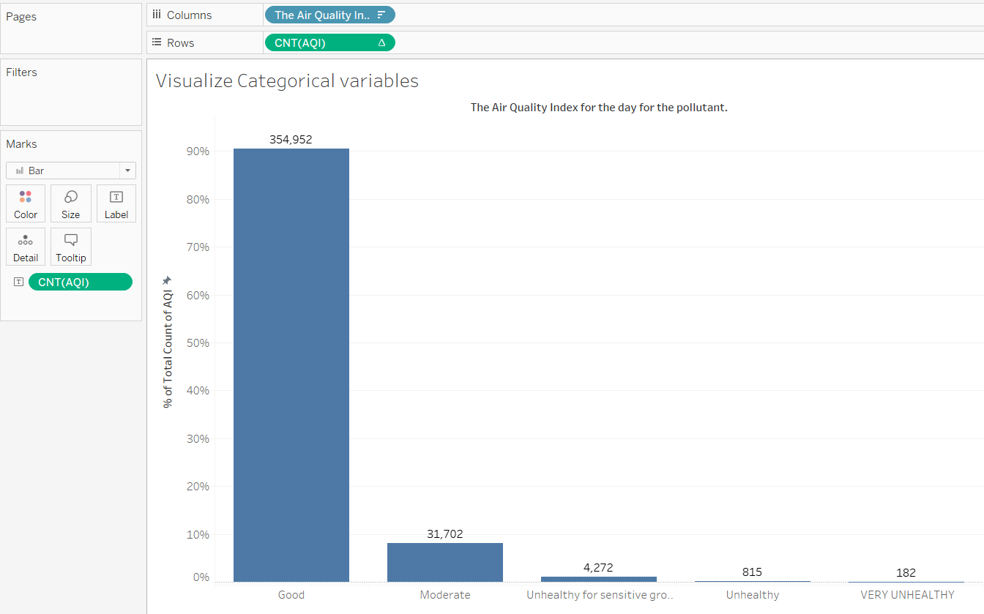
Visualize Categorical variables
Here i can see the
air quality index Classifications
It tells how clean or polluted the air is

Slide 8
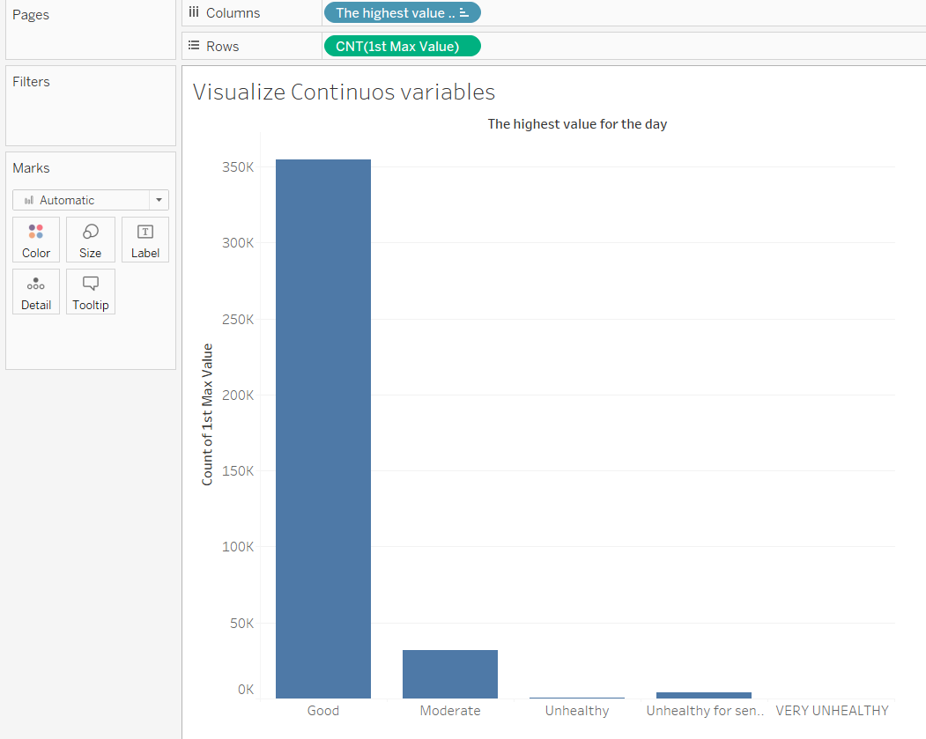
Visualize Continuous variables
Here i can see the
highest value
for the day

Slide 9
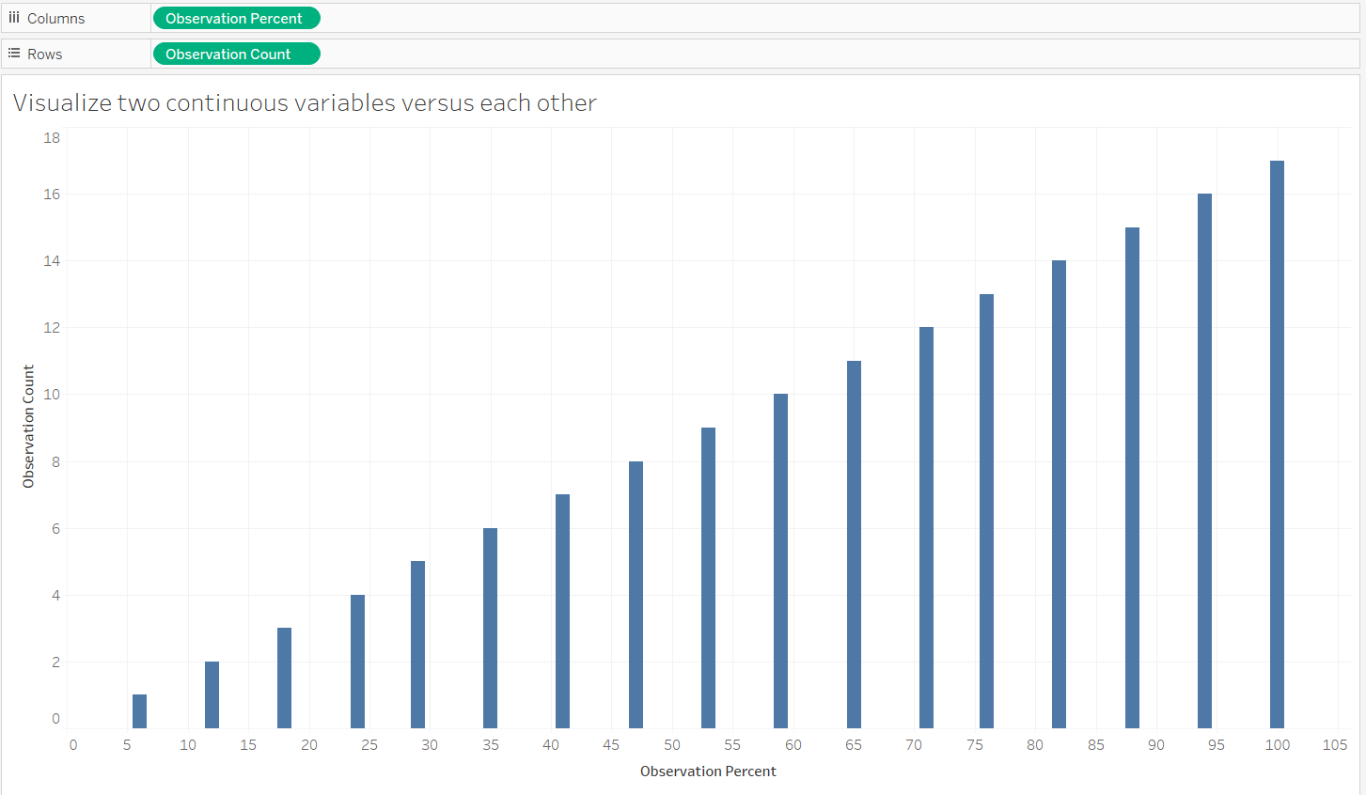
Visualize two continuous variables versus each other
The observation percentage increases with the observation count

Slide 10
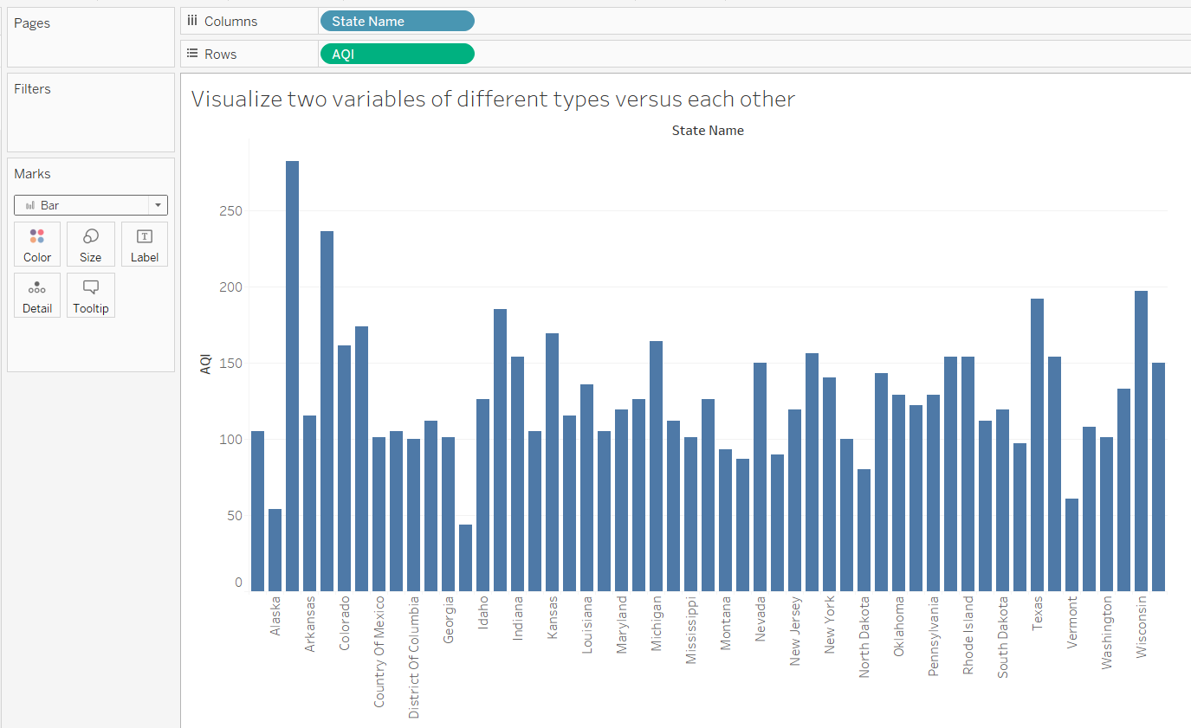
Visualize two variables with different types versus each other
Arizona has the highest air quality index for the day

Slide 11
03
Task
Use at least 2 different geospatial visuals to answer your questions, but they should include at least three different types of maps (point, line, density, filled, layers)

Slide 12
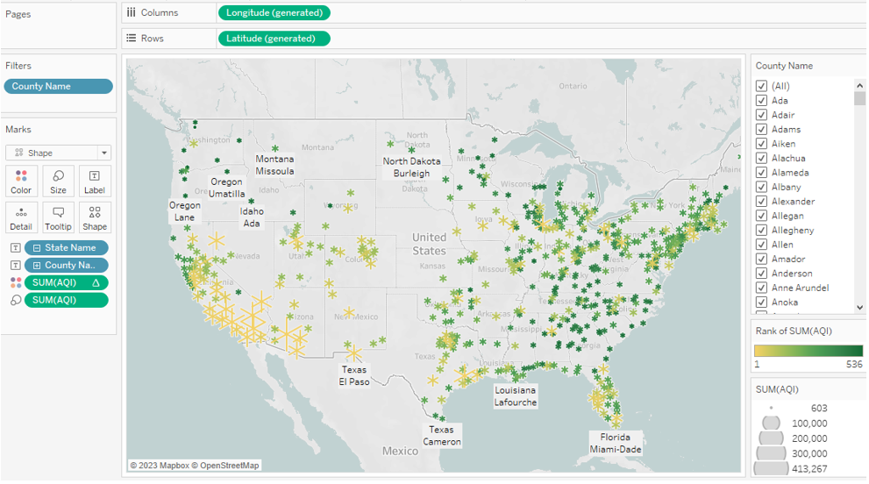
POINT MAPS
This figure shows Point Map with Normal background filtered by country name that represent the sum of AQI in each country and state by using different size, color and shape with showing the name of country & state in map.

Slide 13
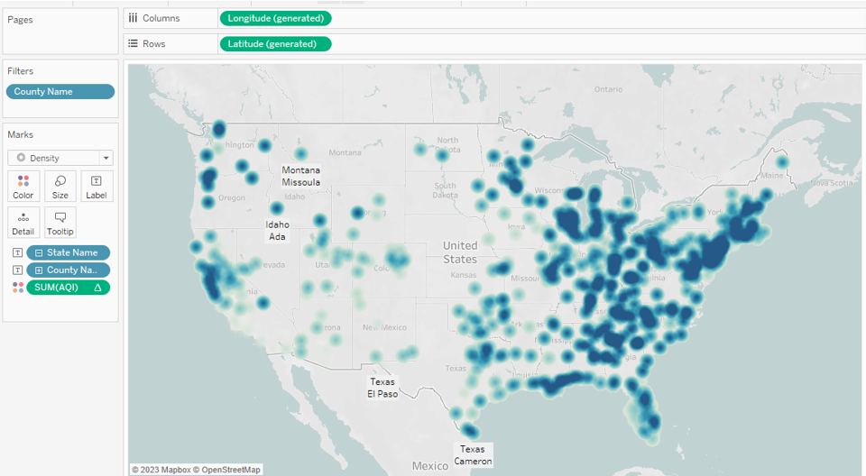
DENSITY MAPS
This figure shows Density Map with Normal background filtered by country name that represent the sum of AQI in each country and state by using different size, color and shape with showing the name of country & state in map.

Slide 14
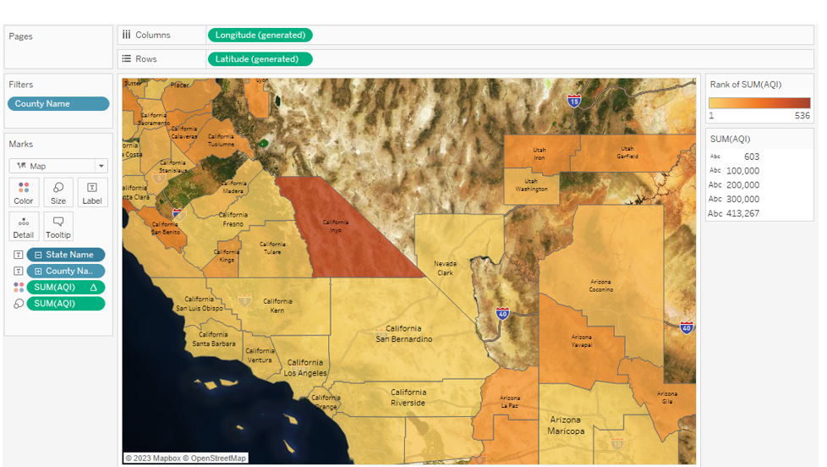
MAP LAYERS
This figure shows Map Layers with Satellite background showing streets, filtered by country name that represent the sum of AQI in each country and state by using different size, color and shape with showing the name of country & state in map.

Slide 15
04
Task
Using the LO,calculated field, table calculation ,filter in your visualizations and Creating a dashboard

Slide 16
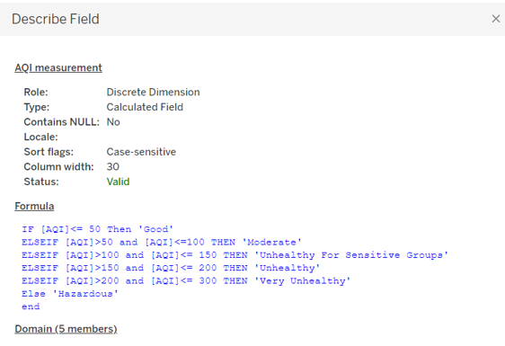
LOD expression

Slide 17
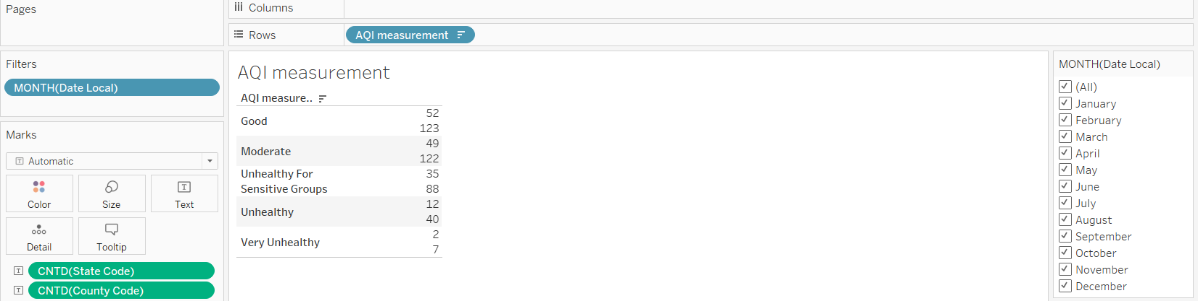
AQI MEASUREMENT
There are 6 air pollution levels (Good, Moderate, Unhealthy for Sensitive Group, Unhealthy, Very Unhealthy, Hazardous). But our dataset contains 5 only.
This table shows the distinct count of state (bottom) and country (top). You can also check the count for each month.

Slide 18
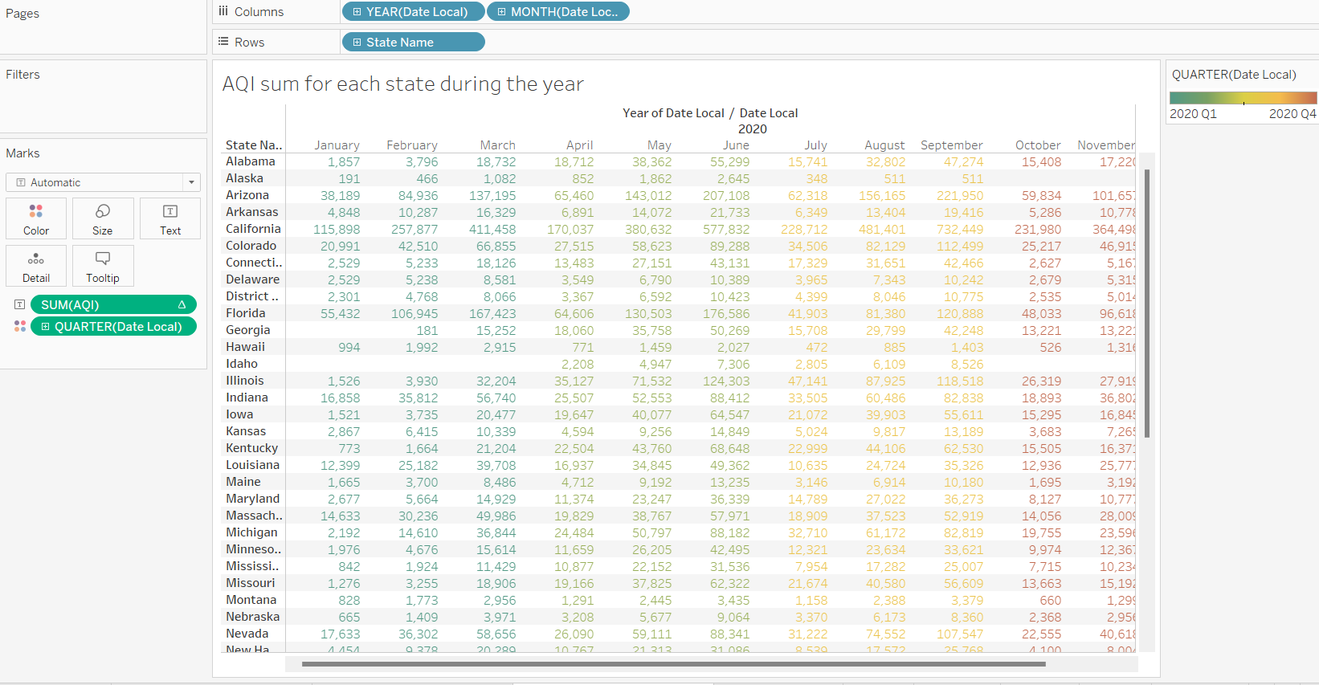
table calculation
This table shows the sum of AQI in each state through the year, and to view the sum of each quarter, we used a colour to easily observe.
To confirm our insights, we notice that California has the highest AQI.

Slide 19
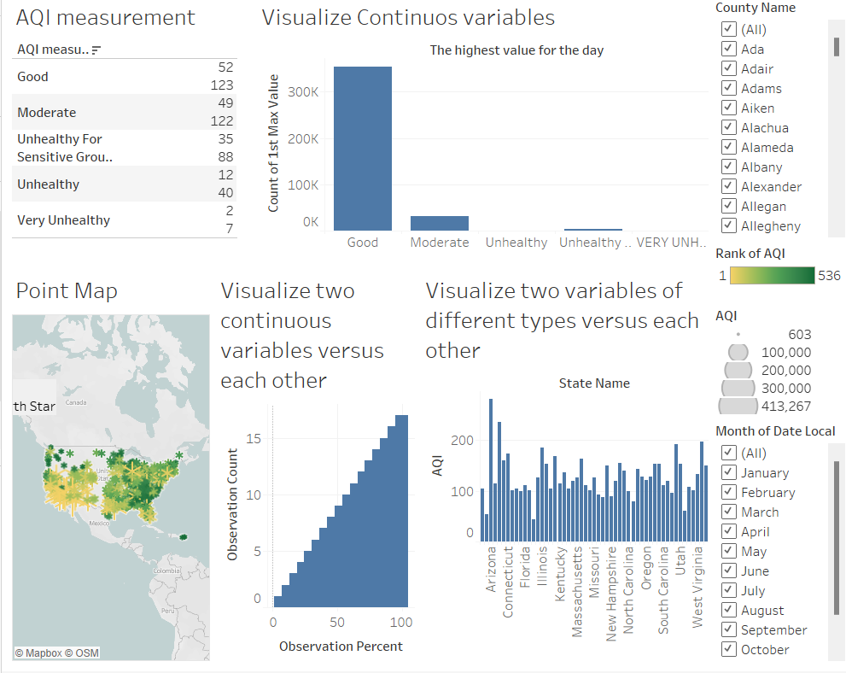
DASHBOARD

Slide 20
Thank you
Any question?

